Slide 1
Rust for Weld
Building a High Performance Parallel JIT Compiler
Shoumik Palkar and many collaborators

Slide 2
Talk agenda
What is Weld?
The path to Rust
Weld + Rust today

Slide 3


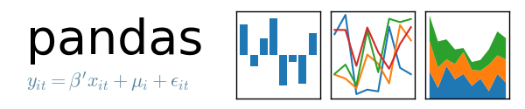
Motivation for the Weld Project
Modern data analytics applications combine many disjoint processing libraries & functions
+ Great results leveraging work of 1000s of authors
– No optimization across functions

Slide 4

How bad is this problem?
Growing gap between memory/processing makes rigid functional call interface worse!
data = pandas.parse_csv(string)
filtered = pandas.dropna(data)
avg = numpy.mean(filtered)
parse_csv
dropna
No trait Iterator in Python/data science libraries ☹
mean
Up to 30x slowdowns in popular libraries compared to an optimized C or Rust implementation

Slide 5


Weld: a common runtime for data libraries
SQL
machine learning
graph algorithms
…
Common Parallel Runtime
…
CPU
GPU

Slide 6
Weld: a common runtime for data libraries
SQL
machine learning
graph algorithms
…
Runtime API
Weld
runtime
Weld IR
Optimizer
Backends
…
CPU
GPU

Slide 7
Life of a Weld Program
User Application
data = lib1.f1()
lib2.map(data,
item => lib3.f2(item))
Data in application
Runtime
API
libweld.dylib
Weld
managed
parallel runtime
f2
map
11011100111010110111101001010101010101000111
f1
IR fragments
for each function
Combined
IR program
Optimized
IR program
Machine
code

Slide 8
Weld for building high performance systems
Beyond cross-library optimization, Weld is useful for:
Building JITs or new physical execution engines for databases
Building new JITing libraries
Targeting new hardware using the IR (first class parallelism)

Slide 9
Weld can provide order-of-magnitude speedup
Data cleaning + lin. alg. with Pandas + NumPy: 180x speedup
Image whitening + linear regression with TensorFlow + NumPy: 8.9x speedup
Linear model evaluation with Spark SQL + user-defined function: 6x speedup

Slide 10
Demo
Compiling a simple Weld program in the REPL
Notes:
You can build the REPL and play around with it yourself at https://www.github.com/weld-project/weld

Slide 11

First Weld compiler implementation:
The Good:
+ Algebraic types, pattern matching
+ Large ecosystem
+ My advisor liked it

Slide 12
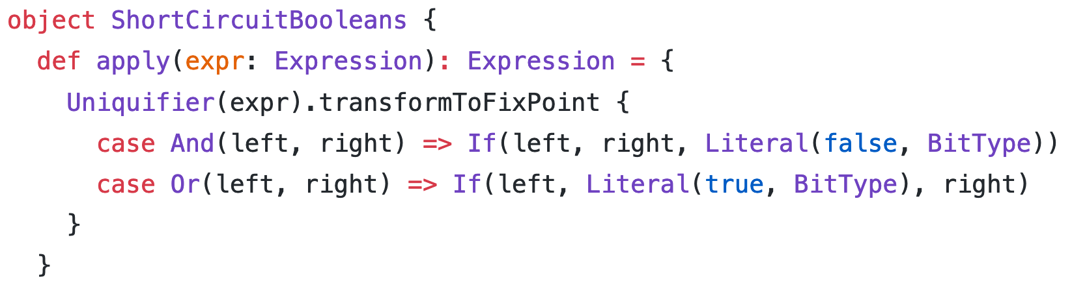
First Weld compiler implementation:
The Good:
+ Algebraic types, pattern matching
+ Large ecosystem
+ My advisor liked it
Functional paradigms especially nice for compiler optimizer rules

Slide 13
First Weld compiler implementation:
The Bad:
Hard to embed
JIT compilation times too slow
- Managed runtime (JVM)
Clunky build system (sbt)
Runtime had to be in different language (C++)

Slide 14
Wanted to re-design the JIT compiler, core API, and runtime.
Strong support for parallelism, C-compatible native memory layout
Pattern matching, algebraic data types, performance
Mechanisms to build C-compatible FFI

Slide 15
The Path to Rust

Slide 16
Requirements
Fast
  compilation happens at runtime
Safe
  embedded into other libraries
No managed runtime
  Embedded into other runtimes
Rich standard library
  Data structures for compiler and optimizer
Functional paradigms
  Pattern matching for optimizer
Good managed build system

Slide 17
The search for a new language
Golang
Fast
Java
C++
Rust
Python
Swift

Slide 18
The search for a new language
Golang
Fast
Safe
Java
C++
Rust
Swift

Slide 19
The search for a new language
Golang
Fast
Safe
No managed runtime
Java
Rust
Swift

Slide 20
The search for a new language
Rust
Fast
Safe
No managed runtime
Rich standard library
Functional paradigms
Good package manager
Swift

Slide 21

The search for a new language
Rust
Fast
Safe
No managed runtime
Rich standard library
Functional paradigms
Good package manager

Slide 22
Weld in Rust

Slide 23
Weld in Rust, v1.0: native compiler
Python bindings
C API for bindings
Core Weld API
Java bindings
Optimizer
…
crate cweld
(Built as dylib)
Compiler backends
C++ Runtime to manage threads, memory, etc.
Rust ←→ C++ auto-generated bindings
crate weld
libweldruntime.dylib

Slide 24
IR implemented as tree with closed enum
/// A node in the Weld abstract syntax tree.
struct Expr { kind: ExprKind, ty: Type }
/// Defines the kind of expression.
enum ExprKind {
UnaryOp(Box<Expr>),
BinaryOp { left: Box<Expr>, right: Box<Expr> },
ParallelLoop { /* fields */ },
...
}

Slide 25
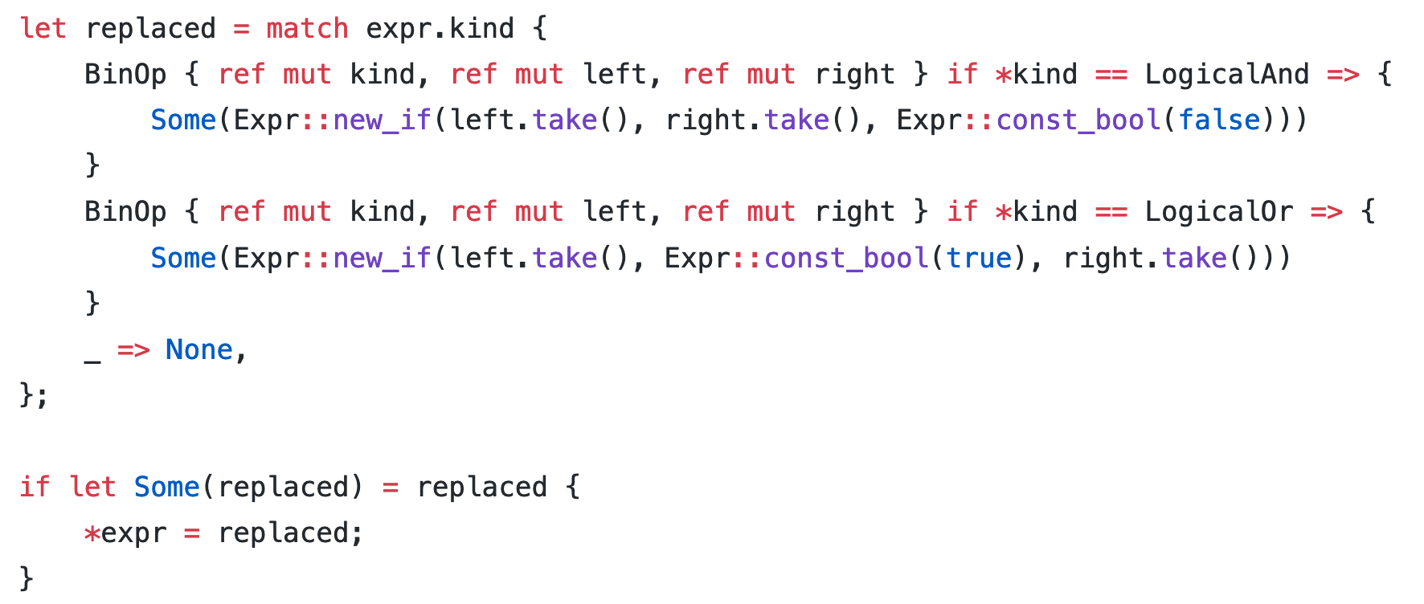
Transformations with pattern matching
Pattern matching rules similar to Scala.
1
Match on target pattern
2
Create substitution
3
Replace expression in tree in-place

Slide 26
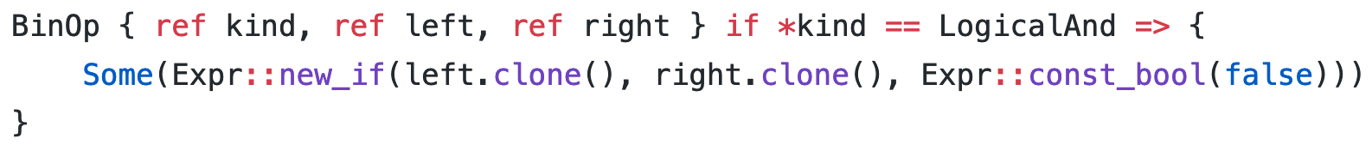
Performance note: living without clone
Tricky with trees and graphs in Rust: clone() is an easy escape hatch! Simple example with old code:
Especially tricky to avoid (for us as newcomers) due to pointer-based data structure + borrow checker
Especially fatal for performance ( due to recursive clones)

Slide 27
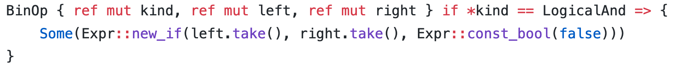
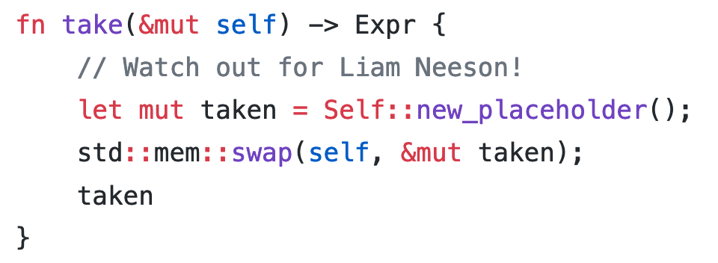
Performance note: living without clone
Tricky with trees and graphs in Rust: clone() is an easy escape hatch! Simple example with new code:
Simple solution gives over 10x speedup over cloning for large programs

Slide 28
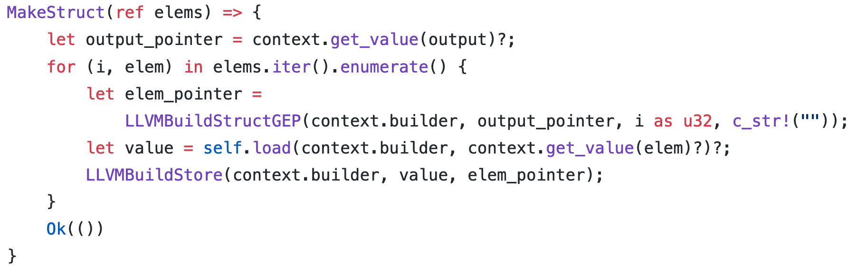
Unsafe LLVM API for code generation
Pleasantly easy to interface with C libraries (*-sys paradigm)
LLVM C API calls

Slide 29
Easy-to-build FFI
vs. Scala: no need for wrapper objects, interact with GC, etc.
#[repr(u64)]
pub enum WeldConf {
_A,
}
#[allow(non_camel_case_types)]
pub type weld_conf_t = *mut WeldConf;
#[no_mangle]
pub extern "C" fn weld_conf_new() -> weld_conf_t {
Box::into_raw(Box::new(weld::WeldConf::new())) as _
}
Can almost certainly automate this with procedural macros
(we haven’t tried)

Slide 30
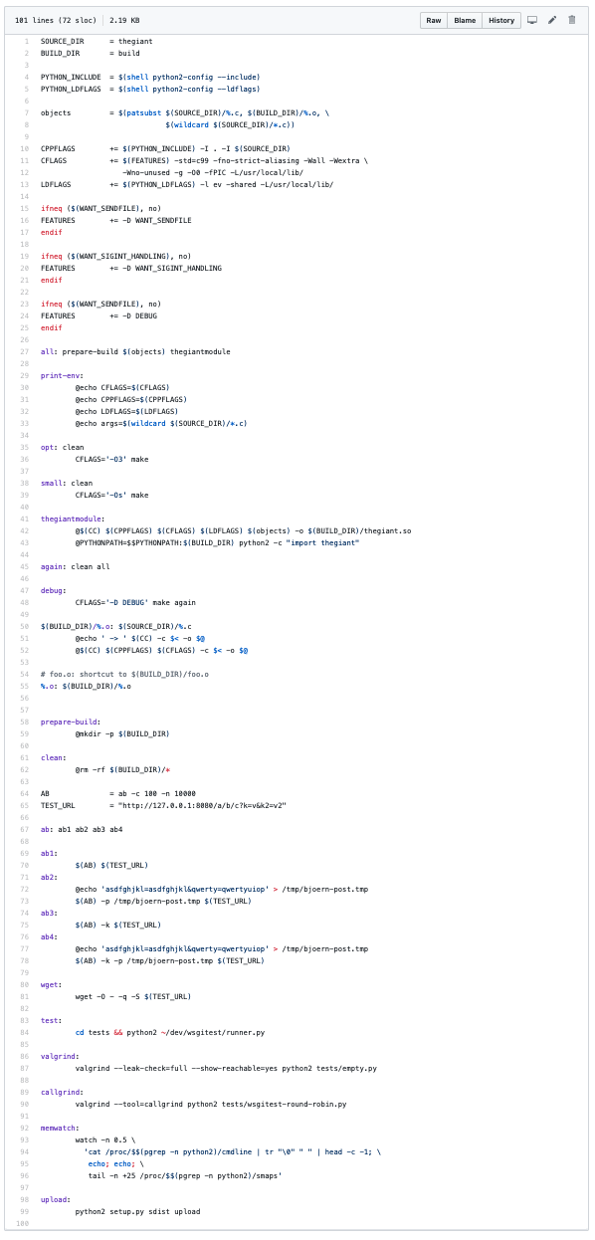

Cargo to manage…everything
Automatic C header generation
Workspaces to build tools automatically
Docs, testing, etc. etc.
I still don’t know how to write a (proper) Makefile from scratch.

Slide 31
Life was good, but we still had that pesky C++ parallel runtime…
  Concurrency bugs unrelated to generated code, two codebases, complex build system, two logging and debugging systems, etc.

Slide 32
Weld in Rust, v2.0: Rust parallel runtime
Python bindings
C API for bindings
Core Weld API
Java bindings
Optimizer
…
crate cweld
(Built as dylib)
Compiler backends
Rust parallel runtime
Saf(er) than C++ (no guarantees with JIT)
Single logging and debugging API
Easier to pass info from runtime to compiler
crate weld

Slide 33
Parallel runtime in Rust
JIT’d machine code calls into Rust using FFI-style functions
pub type JITFunc =
unsafe extern "C" fn(*mut c_void, thread: u32);
#[no_mangle]
pub extern "C" fn run_task(func: JITFunc,
arg: *mut c_void);

Slide 34
Parallel runtime in Rust
Tasks executed using Rust threads.
JIT’d LLVM code
Rust-based Runtime
% LLVM Generated Function
define void @f1(u8*, u32) { … }
%13 = load %s0*, %s0** %14, align 8
%.unpack = load i32*, i32** %.elt9
%.unpack2 = load i64, i64* %.elt1 %capacity.i.i = shl i64 %.unpack2, 2
call void @run_task(%JITFunc %f1, …)
run_task(func: JITFunc, …) {
thread::spawn(|_| {
...
f1(...)
});
}

Slide 35




Interested? We’d love contributors!
Today: 30+ total contributors, 1000+ GitHub stars
Many things to do!
  More compiler optimizations, better code generation, better debugging tools for generated code, nicer integrations with libraries, better GPU support, etc. etc.
Contributions by others in academia, industry

Slide 36






Thanks to the Stanford Weld team!
Deepak Narayanan
James Thomas
Matei Zaharia
Parimarjan Negi
Pratiksha Thaker
Rahul Palamuttam

Slide 37
Conclusion
Rust is a fantastic fit for building a modern high performance JIT compiler and runtime
  Functional semantics for building compiler
  Native execution speed for runtime, low level control
  Seamless interop with C → hooks into other languages
Contact and Code
shoumik@cs.stanford.edu
https://www.weld.rs

